Slide 1
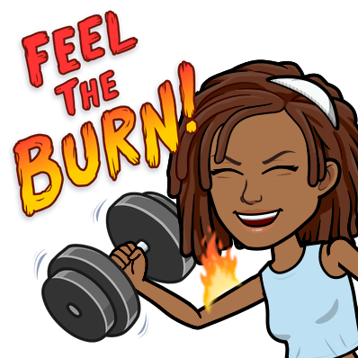
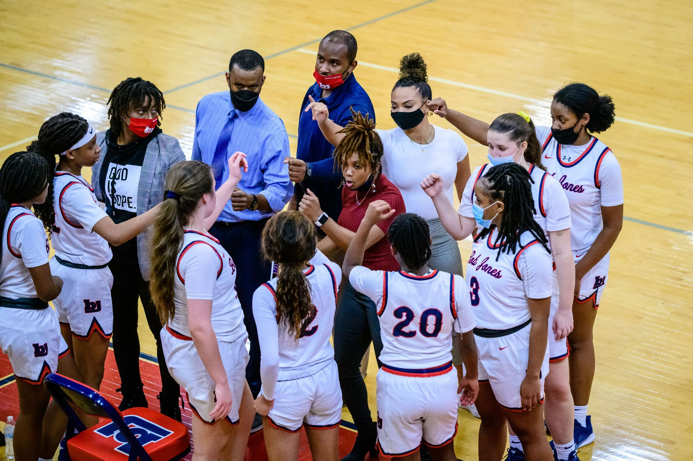
LIFE PE
Coach Powers
Email: jpowers@madisoncity.k12.al.us

Slide 2
PURPOSE & FOCUS
LIFE PE- Lifelong Individualized Fitness Education
To Educate & Promote Physical Literacy for a Lifetime of Healthy Living
Physical Literacy Involves Having Knowledge, Skills, and Confidence to Enjoy a Lifetime of Healthy Living

Slide 3
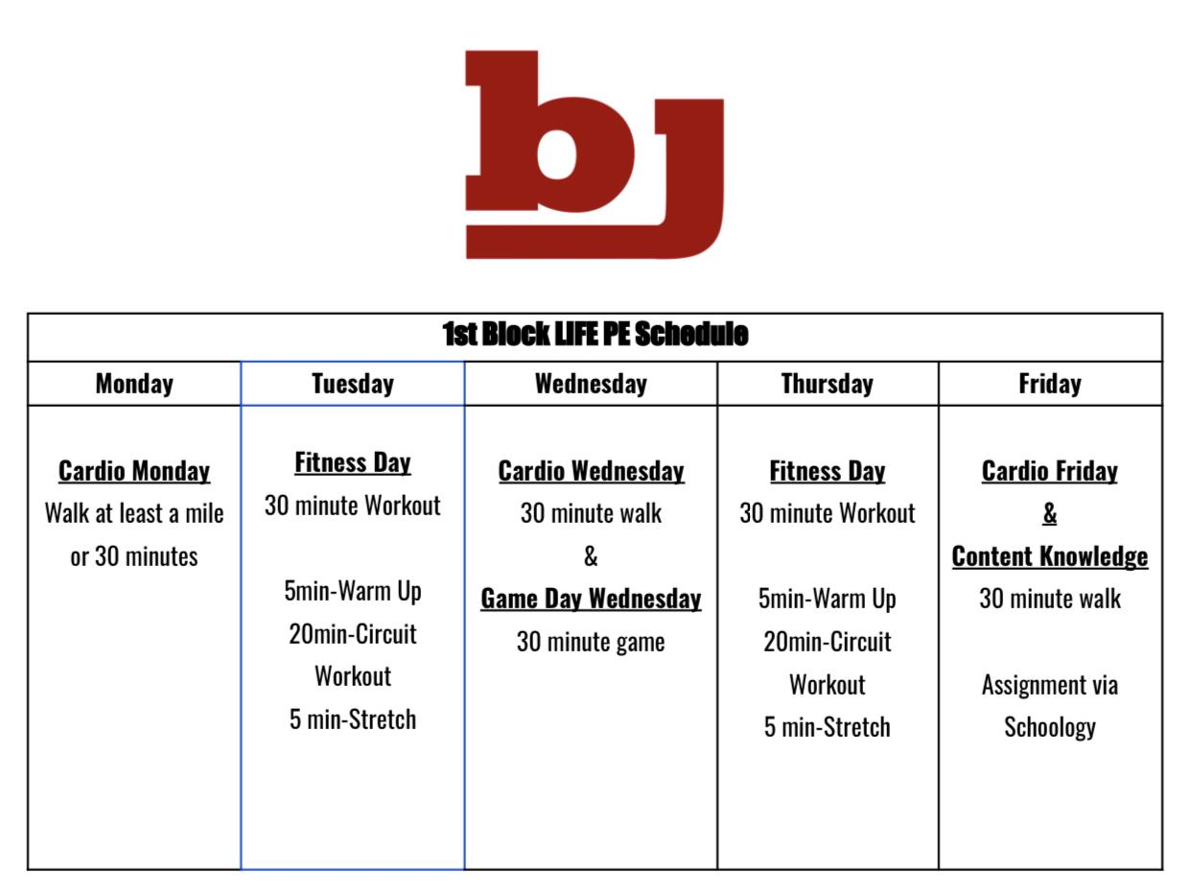
COURSE OUTLINE
This course will involve a daily “PA” or physical activity component.
Students will also have a content knowledge component consisting of assignments, articles, & videos related to physical activity, fitness, and health.

Slide 4
EXPECTATIONS
Biggest expectation is PARTICIPATION!
Be Respectful to Everyone
Have A Good Attitude
PARTICIPATE

Slide 5
GRADING
Participation
(Fitness Workouts, Physical Activities) 70%
Mondays-Friday
Content Knowledge
(Assignments, Articles, Videos, Discussion)- 30%
Fridays
Grades will be in Powerschool!!!

Slide 6
Schedule & Office Hours
Coach Powers
1st Block | LIFE PE 8:15- 9:51
2nd Block | Health Education
3rd Block | Office Hours
4th Block | Girls Basketball

Slide 7
Contact Info
Feel free to email me anytime jpowers@madisoncity.k12.al.us
Office Number- 256-772-2547

